Slide 1


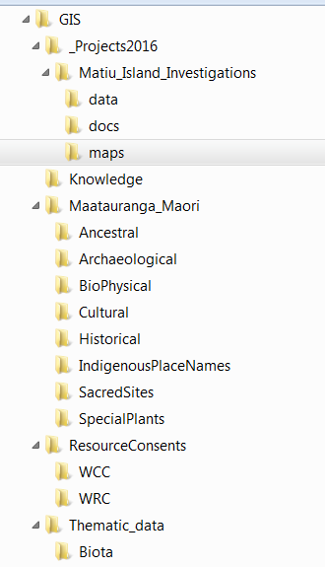
Iwi Māori GIS data structure example template
DRAFT
G:/ GIS Root Folder
Maatauranga_Māori
Māori_Values
Māori_Knowledge
RMA_Process
_Projects2016
Thematic_Data
Ancestral
Sites including traditional land tenure, historical tracks
Air
Detailed or confidential information on air and space
Silent_Concealed_Files
Recording the information in an archive or filing system linked to a GIS database or a map
DistrictCouncil1
Title_Place_Date_Comment
Farming
DistrictCouncil2
docs
Biota
Archaeological
Cooking sites, tools, weapons, artefacts.
Animals_Birds_Fish_Insects
Special animals, birds, fish, insects, special foods, cultural harvest, fishing grounds
DistrictCouncil3
data
InlandWaters
Overlay_Grid
To flag sensitive areas, recording the information for example as a grid network which does not identify the actual position or location of confidential or sensitive information.
DistrictCouncil4
maps
Boundaries
Biophysical_Resources
Landforms, soils, forma and fauna, water quality, geothermal and coastal resources.
Lands_and_Soil
Special landmarks, land features, traditional knowledge on soils and cultivation, muds/dyes for weaving etc.
RegionalCouncil1
Title_Place_Date_Comment
Location
RegionalCouncil2
docs
ClimatologyMeteorology
Cultural
Cultural and Social sites such as Marae which exist today.
Links_to_Books_Maps
A directory to direct the enquirer to associated knowledge in books and maps
data
Oceans
Meta_Physical
Detailed or confidential metaphysical information (such as spiritual, cosmological)
maps
Economy
Historical
Historic places, and tribal landmarks, Fortified villages, hills, rocks, rivers
Links_to_people
A directory to direct and enquirer, via a Maori organisation or contact, to an individual for answers to particular questions and associated traditional knowledge.
PlanningCadastre
Implementation Example:
Vegetation
Vegetation and land use, plan uses, plant varieties, medicinal plants for weaving.
Elevation
Indigenous_Place_names
Correcting the spelling and adding place names to maps, recording knowledge/histories about indigenous place names.
Environment
Water
Detailed or confidential information on water, including environmental monitoring.
Geoscientific
GIS_System_information
Guidance, process documentation, scripts etc.
Sacred_Sites
Historical burial sites, sacred battle grounds.
Structure
Special_Places
detailed or confidential information on special places, cultural and historic sites
Software
Society
Special_plants
Special types of trees, plants used for weaving, wood for carving, traditional medicines.
Scripts
Structure
Reference_material
Transportation
About
This diagram is an example for reference to support groups wanting to develop a shared and structured GIS file, folder and database system. It is based on the work of Garth Harmsworth from Landcare NZ and ISOTC211.
Training_Guides
Health
UtilitiesCommunication

Slide 2
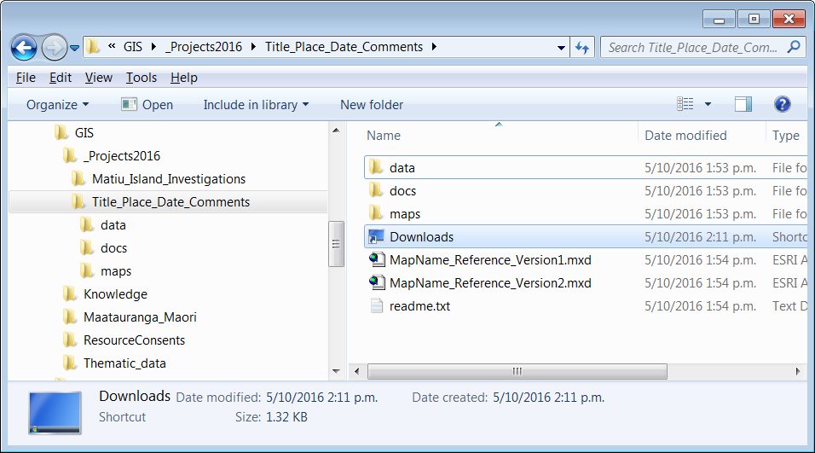
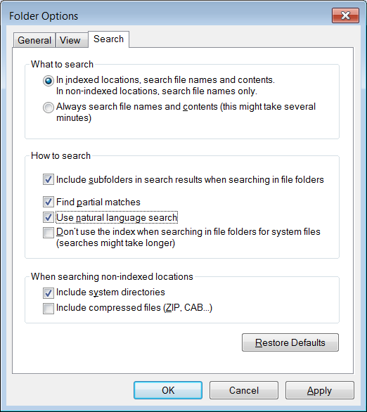
File management good practice guidance.
DRAFT
Use the fewest folders necessary to organise your data. Consider how many directory trees you will navigate up and down, and optimise for a happy medium of selecting and scrolling. Eg – avoid long folder lists to reduce scrolling and reading folder lists. Only create new folders as you need them, avoid empty folders.
Avoid deep path structures to save navigation time.
Use_Underscores_for_spacing ( _ )
Do not use spaces or non letter characters.
Use the hyphen - if-you-need-to-break-up-the-descriptive-text.
File Naming
Use plenty of “elements” within your folder and file names, eg dates, locations, type, theme, category, owner, project name, phase, stage, etc to keep both the depth of folders small, and the number of folders at the same level to reduce scrolling and reading.
Create an empty folder template with all the subfolders for that project – and use an empty version to copy paste so you will not have to recreate every time.
_ProjectsYYYY are the working directory, or the nearest equivalent of MyDocuments.
This format makes finding old projects in the future easier and you get a clean slate once a year.
Enable searching under the Tools > Folder Options > Search. Configure as shown:
Consider the first letter used as it will determine the sort order if using alphabetical filing.
Consider starting over. Start fresh with a clean, well planned folder structure if your current method is too challenging to tidy.
Versioning – use save as often to avoid single file corruption loss.
Organise using type when you will have many similar files for the same project, but pay attention to your versioning and descriptive naming method. Eg, put all the Shapefiles, KML or geodatabases for this project in the data folder regardless of their purpose.
Organise using Purpose, not type at higher thematic levels. Eg, descriptive words, not groups of file types eg not “DOCs” or “Email”.
Use Shortcuts – right click in the folder you want to have the link from, and then follow the wizard. Alternatively copy a folder, but paste on the right click using shortcut.

